Slide 1
Extra! Extra! Read All About the Universe!
Barb Mattson, PhD (USRA/NASA/GSFC)
Sara Mitchell (Syneren/NASA/GSFC)
Teaching and Learning 2014
March 14, 2014 (Happy Pi Day!)

Slide 2
Outline
What is Cosmic Times?
A taste of Cosmic Times
1955 – Big Bang versus Steady State
1965 – Breaking the Stalemate
1993 – Cosmology’s End?
2006 – Continuing Story
Tools for tailoring Cosmic Times to your classroom

Slide 3
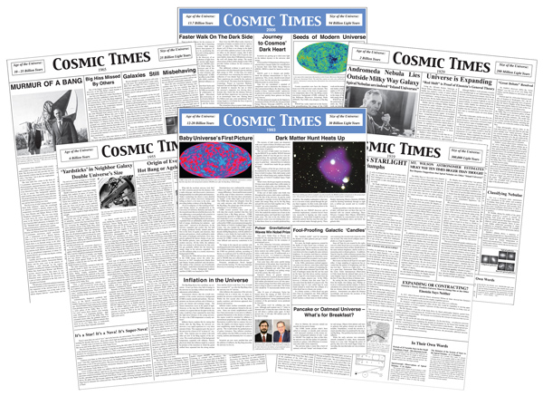
What is Cosmic Times?
Suite of curriculum support materials tracing our understanding of the expanding universe
Includes:
6 posters resembling front page newspapers 1919 to 2006
3 newsletter versions of each poster, two at differentiated reading levels
4-5 lesson plans for each poster exploring fundamental science, social context, and reading skills
You will receive the Cosmic Times posters and a DVD containing materials at the end of this workshop
Notes:
Cosmic Times is a series of fictional front-page newspapers that trace our understanding of the nature of the universe from 1919 to modern times.
By framing these materials as newspapers, students not only get to understand the science involved in our understanding, but see the very process of science at work. Cosmic Times was developed to answer the need for literacy materials in the science classroom.
We have developed classroom-tested lessons to accompany each poster, including reinforcing basic science skills, using data in the classroom, and multidisciplinary activities. In addition, we have produced text at three differentiated reading levels in the form of newsletters printable at 8.5x11” to reach the maximum number of students.

Slide 4
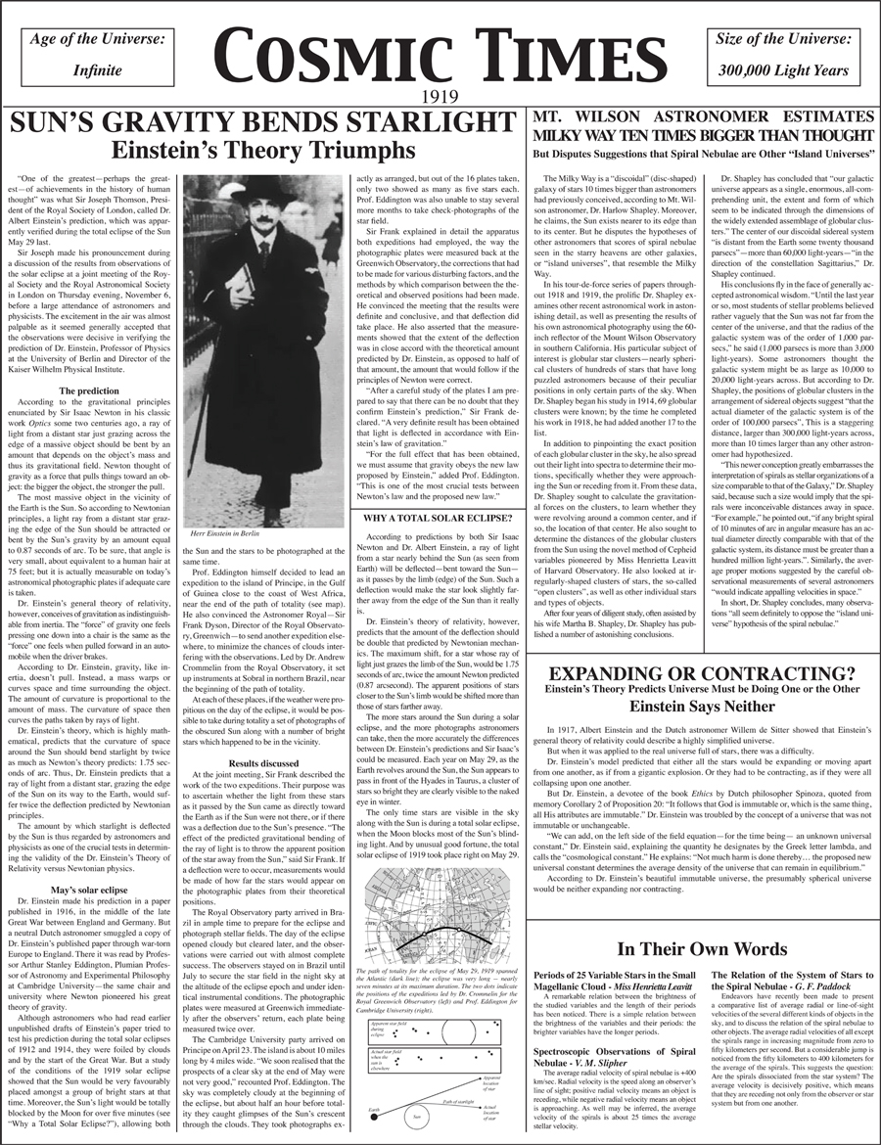
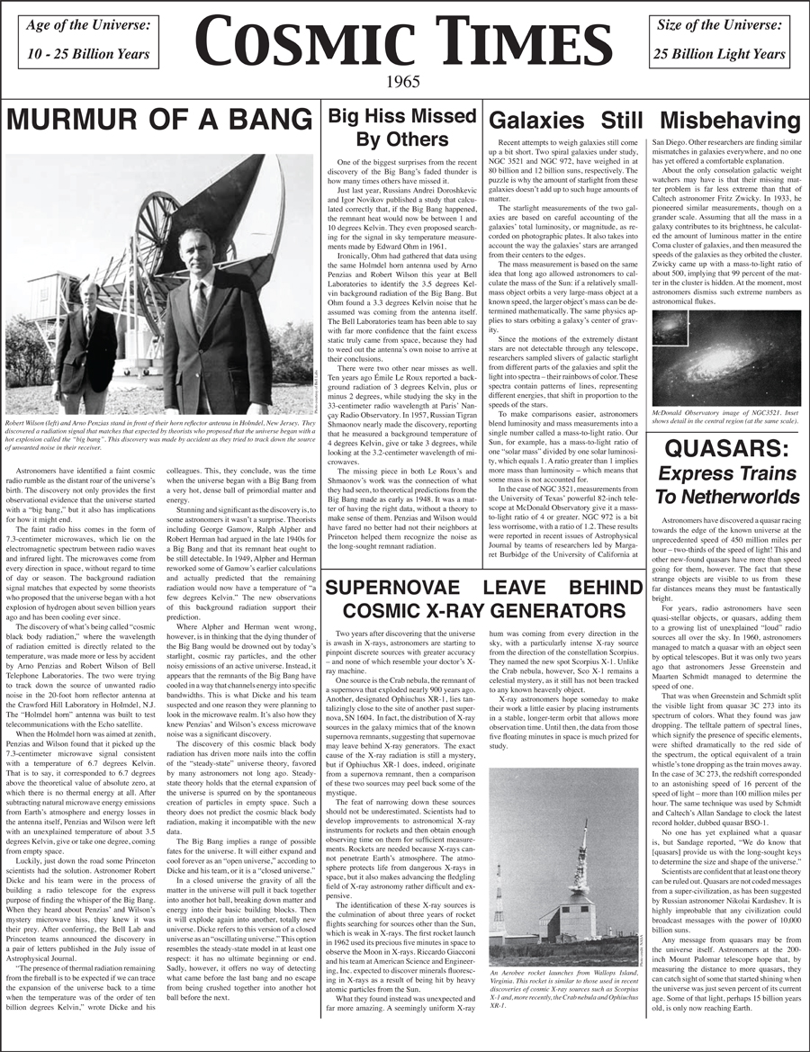
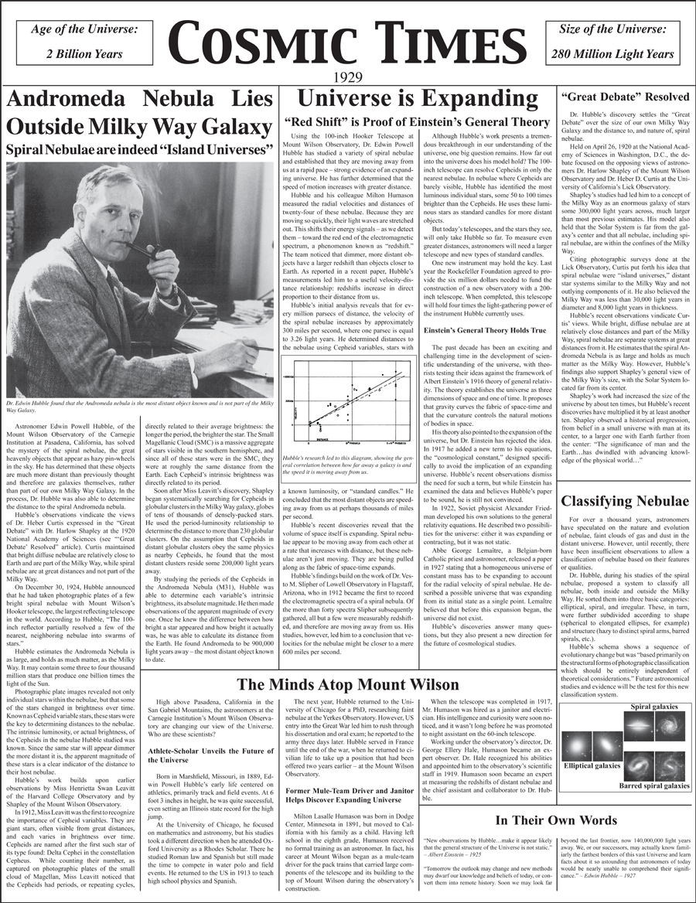
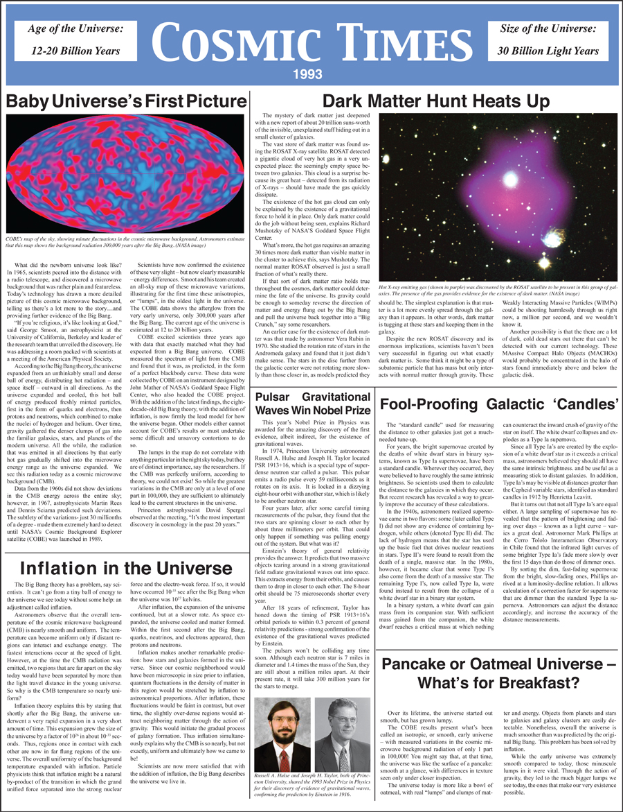
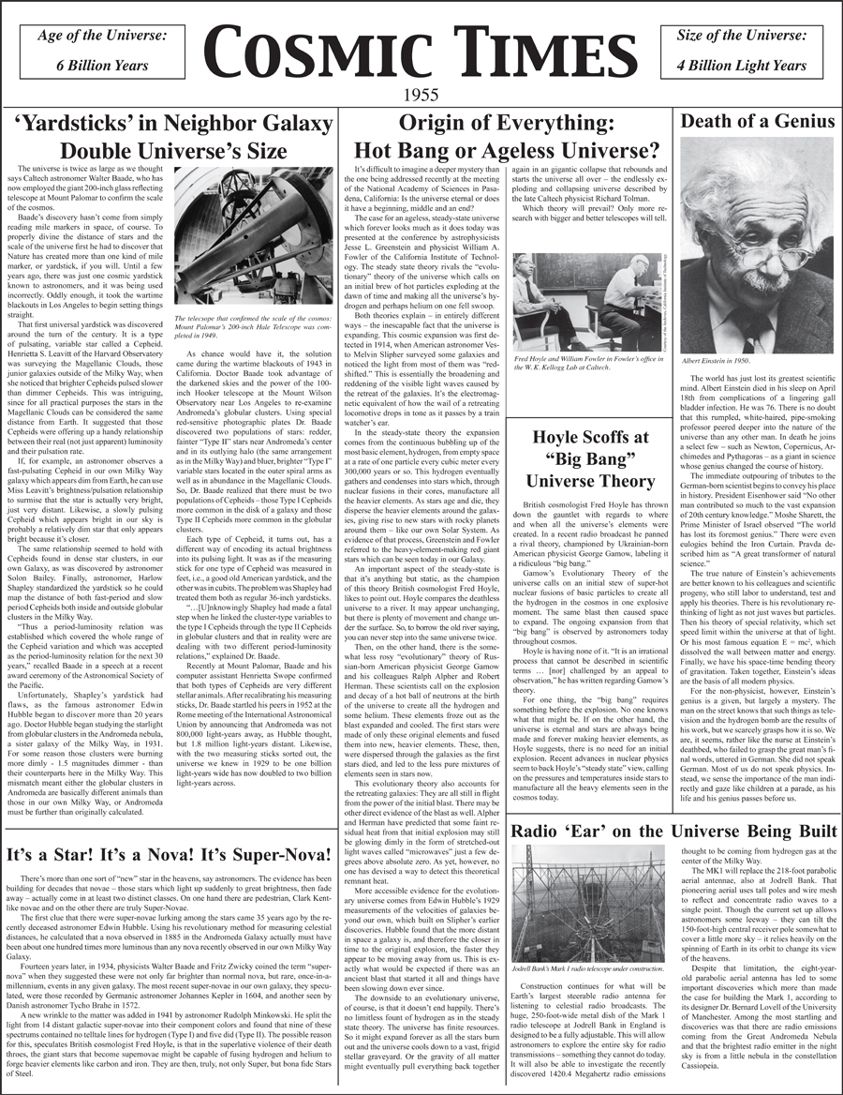
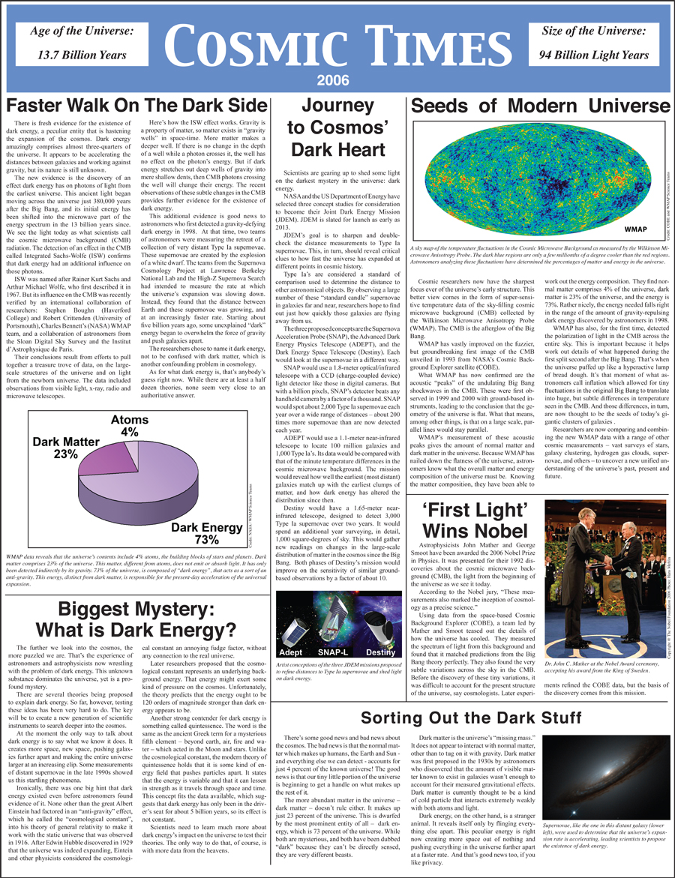
Expanding universe
Size of the universe
Nature of supernovae
Notes:
There are three major threads to the story – the expanding universe, measuring distances in the universe, and the nature of supernovae.
In this workshop, we will follow part of the expanding universe thread, starting in the middle of the story, to get a flavor of the Cosmic Times articles and activities.

Slide 5
Quick notes on 1919
The universe was believed to be:
300,000 light years (size of Milky Way)
Static
Timeless
Einstein’s General Theory of Relativity (1916) revolutionized scientists’ view of gravity
Observations of the 1919 total solar eclipse supported Einstein’s theory
Fundamental science concepts: motions of the Earth, Moon & Sun, solar eclipse, gravity, curved space-time
Notes:
Before jumping in to the middle of the story, let’s get a brief overview of the story so far.
The first issue of Cosmic Times comes from 1919. At this time, the universe was believed to be some 300,000 light years in extent (basically, the size of the Milky Way galaxy). It was also believed to be static, or unchanging, over time, and timeless.
In 1916, Einstein published his General Theory of Relativity, which gave scientists a new way to think about gravity. It was in 1919, however, that the first observational confirmation of Einstein’s theory came, which is when the whole scientific community started taking it seriously and rocketing Einstein to fame.

Slide 6
Quick notes on 1929
Edwin Hubble discovers:
Milky Way is but one of many galaxies
Universe is expanding
Fundamental science concepts: redshift, distance to galaxies, Cepheid variables (patterns in data)
Notes:
We next pick the story up in 1929. At this time, Edwin Hubble – the original “Hubble” – has made a couple of fundamental discoveries about our universe.
The first discovery was that our Milky Way galaxy was not the full extent of the universe. In fact, it is just one of many galaxies in our universe.
His observations of distances to the other galaxies coupled with previous observations of the “redshift” of those galaxies told him that those galaxies were all, with only a couple exceptions, moving away from us. In fact, they were moving in such a way that it indicated that the universe was expanding.
So not only did he increase the size of the universe as we knew it, but he showed that it was not unchanging.

Slide 7
1955 – Origin of the Universe
Scientists debate: is the universe:
ageless and infinite?
finite, with hot “bang” beginning?
Notes:
The next issue of Cosmic Times picks up the story in 1955. At this time, scientists are debating the origin of the universe – has it been around forever? Or did it have a hot, dense beginning?
Rather than tell you about these theories, I’m going to let you read about them yourselves using one of the reading strategies put forth in one of our lesson plans.

Slide 8
Reading Strategies
Use one of the reading strategies to understand the CT article “Origin of Everything”
Notes:
One of the Cosmic Times lesson plans give a couple of reading strategies to help your students understand the readings.
We’ll have you fill in the next piece of the story by practicing one of these reading strategies on one of the 1955 article. However, note that this lesson should come in handy for *any* of the Cosmic Times articles. And, in fact, it could be used in any science classroom to help students read and understand articles on science.

Slide 9
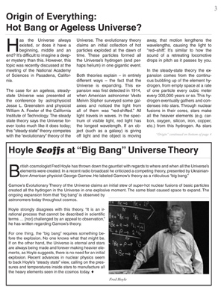
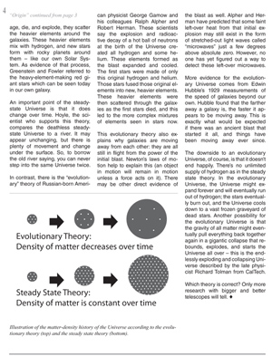
Reading Strategy: Reciprocal Teaching
Pair up
Both partners read the same paragraph (aloud or to yourselves)
One partner summarizes the paragraph for the other
The other partner “checks and perfects” – state what you agree with, question parts you don’t understand, add more information, connect ideas
Read the next paragraph and switch roles
Continue with each paragraph until you’ve read and understood the article
“Origin of Everything” article on pages 3-4
Do Paragraphs 2, 4, 5, 6, 7
Notes:
The strategy you’ll try out is called “reciprocal teaching”.
You should pair up with someone near you.
You will each read one paragraph of the article a the same time – either out loud or to yourselves, it’s up to you. One of you will summarize the paragraph to the other. The other partner then chimes in, saying what they agree with, asking questions, and pointing out things they read differently, etc. When you’ve come to some understanding of that paragraph, move on to the next. For the next one, reverse roles.
In the interest of time, you’ll be doing selected paragraphs from the “Origina of Everything” article – paragraphs 2, 4, 5, 6, 7, as highlighted in the illustration.
Note: For participants who complete this part quickly, have them try the second reading strategy on the article “Hoyle Scoffs”.

Slide 10
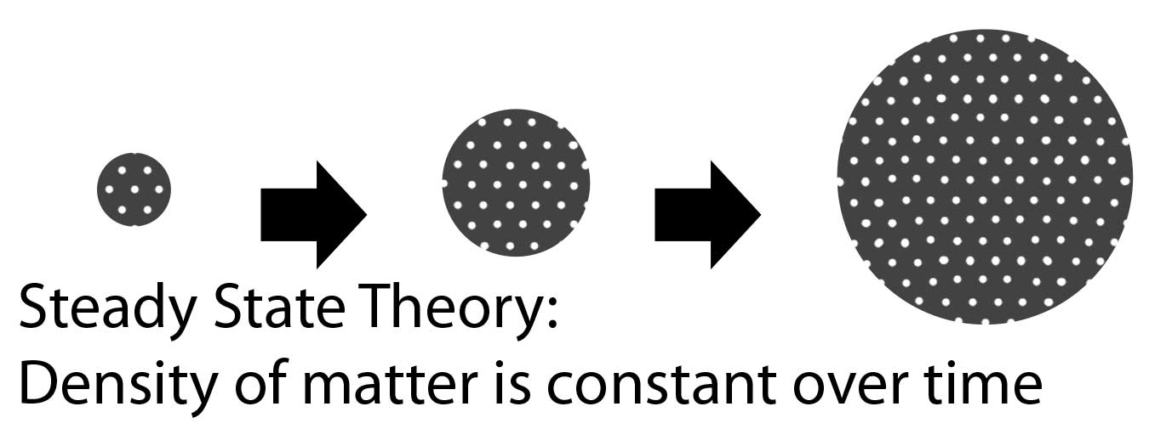
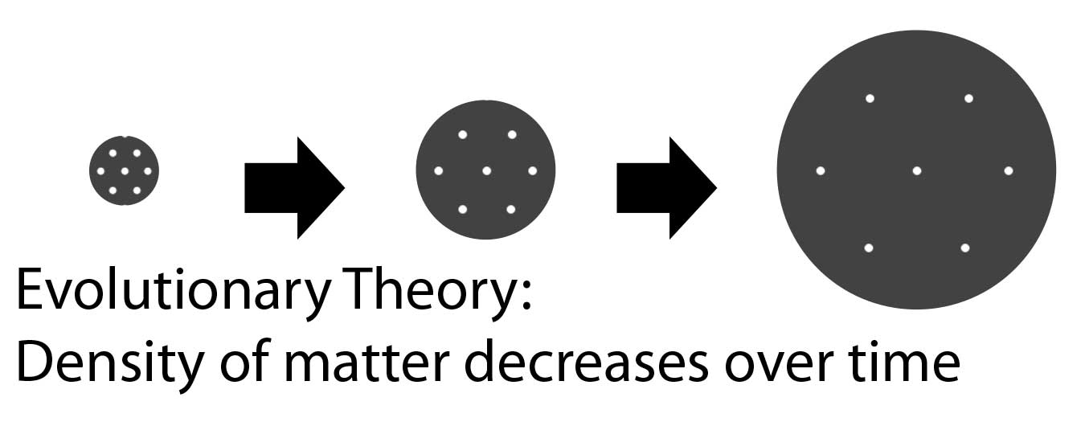
Summarize the Article
Steady State Universe
Evolutionary Universe
Unchanging situations need not be static
New matter can be created spontaneously as the universe expands (a few hundred atoms per year per galaxy)
The universe is constant in its overall density
Universe is expanding from a state of high density and pressure.
Hydrogen & Helium were formed as universe cooled.
There should be left over a background radiation with a temperature of ~ 5 Kelvin
Hoyle scoffed at this theory and coined the term “Big Bang”
Notes:
Take this opportunity to summarize what participants gleaned about Big Big and Steady State theories from their reading. Some of the points they should be sure to hit:
Steady State theory:
Fred Hoyle, Hermann Bondi and Thomas Gold see the movie The Dead of Night, in which the end of the story circles back to its beginning.
Unchanging situations need not be static
New matter can be created spontaneously as the universe expands (a few hundred atoms per year per galaxy)
Expansion of universe and creation of new matter balanced via a negative energy.
The universe is constant in its overall density
Evolutionary theory:
Starting from earlier work, George Gamow & Ralph Alpher worked out the conditions in the early universe
Universe is expanding from a state of high density and pressure.
Hydrogen & Helium were formed as universe cooled.
There should be left over a background radiation with a temperature of ~ 5 Kelvin
Hoyle scoffed at this theory and coined the term “Big Bang”

Slide 11
The Evidence is Clear
Bowl of Evidence
Scientists sort through theories by examining evidence and making inferences
Notes:
Building on the knowledge you’ve gained from reading the article on Big Bang and Steady State, we’re going to do a different type of activity.
Officially it’s called “What is the Evidence”, but we affectionately know it as the “Bowl of Evidence”.
Let’s start by defining “evidence” – ask audience to define what evidence is.
They should come up with things like: observation, something you experience first-hand, direct measurement, something you can see.
Now, what is an “inference”?
They should come up with things like: a conclusions based on evidence, an indirect conclusion, something that is a consequence of an observation.
Good. Now you will try your hand at identifying evidences and inferences using information about the two theories of the origin of the universe.
Get into groups (number of groups depends on audience and number of available card sets). You will get a pack of cards and two sheets of paper. Your job will be to go through the information on the cards and determine if it is a piece of evidence or an inference. Furthermore, you will decide if the card is in support of the Big Bang theory or the Steady State theory. Note that this activity does use modern data, as well as what was known in the mid-50’s.
Notes:
There will be some information on the cards that they don’t understand (like a p-field); get them to understand that they can still make the evidence versus inference determination without fully understanding the information on the card
There are some cards with information that isn’t really relevant – like the fact that Hoyle et al developed the theory based on a movie they saw (so what!).

Slide 12
Steady State vs. Big Bang
Resolution of Steady State vs Big Bang won’t come until the mid-to-late 1960s
But as a competing theory, the Steady State provides the impetus to make observations to test the theories
Note that this lesson can be adapted for any science topic where there are two (or more) competing theories
Notes:
Wrapping up the Bowl of Evidence –
After they’ve gone through the cards, ask one group to give the evidence vs. inference for Steady State.
Is there anyone who disagrees with this group? On which cards?
Now ask another group for evidence vs. inference for Big Bang.
Again, does anyone disagree?
Were there any cards that they had trouble with?
Which theory had more evidence? Which is supported more by inference? Do they have enough information to prove or dis-prove either theory?

Slide 13
1955 – Origin of the Universe
Scientists debate: is the universe:
ageless and infinite?
finite, with hot “bang” beginning?
Both theories account for observations
Deadlock!
Fundamental science concepts: nature of science, origin of the universe
Notes:
As we found out with the evidence vs. inference activity, both theories account for the observations as of the mid-1950s. Scientists of this time were left with a deadlock.

Slide 14
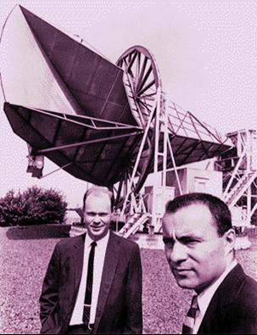
1965 - Breaking the Stalemate
A hot “bang” should leave left-over heat
Data and theory came together in 1965
Penzias and Wilson found a 3 K residual noise while making radio observations of the Milky Way
Peebles and Dicke (Princeton) had just calculated an estimate for the temperature of the residual background in the microwave region
Fundamental science concepts: spectra, electromagnetic spectrum, origin of the Universe
Notes:
One key prediction of the big bang theory was that the universe was once in a hot, dense state. There should be some leftover radiation from that era – though researchers were not certain what exact wavelength it would be at, nor were they sure that it would be a strong enough signal to observe.
Penzias and Wilson stumbled upon the discovery when they found a residual signal in the Holmdel Horn. They realized what it was only when they were made aware of the research by Peebles and Dicke – research and theory had to come together for the discovery to be made.
A few notes:
In the microwave region of the spectrum, astronomers often refer to the temperature of the radiation, rather than its wavelength of frequency.
Big Bang theory predicted the cosmic microwave background – steady state had no such prediction.
Note that this radiation is called the cosmic microwave background because the radiation, in the shape of a black body, peaks in the microwave region.

Slide 15
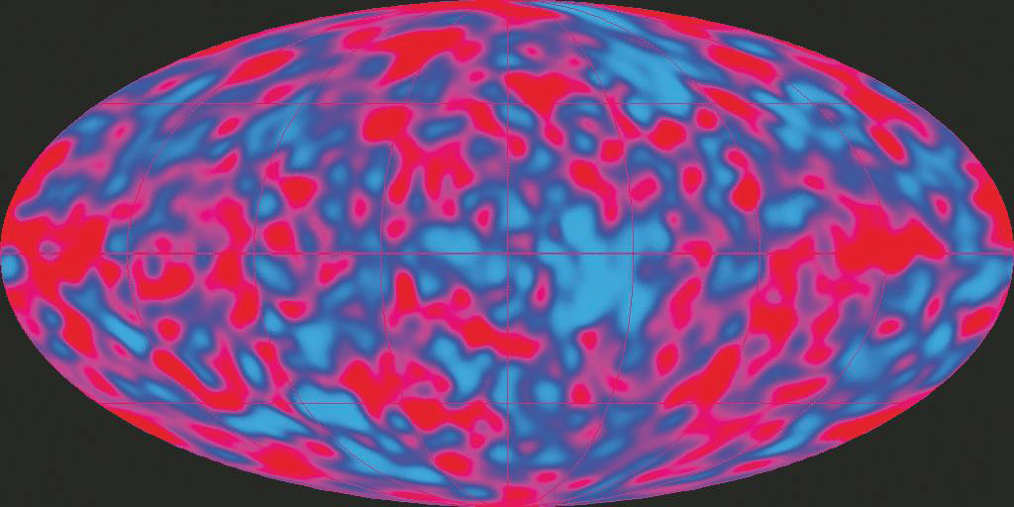
1993 - Cosmology’s End?
By the mid-90s, cosmologists thought that they had only to “fill in the details”
Remaining questions:
Will the expansion continue forever, or will universe eventually collapse back on itself?
What is the mass-density of the universe (which would answer the above)?
Notes:
Once they discovered the CMB, researchers realized that Big Bang theory was the correct theory of the origin of the Universe.
They continued to study the CMB, discovering it’s shape was very nearly a perfect black body. They also mapped out the CMB, finding the signature of regions where structure in the universe began.
In two of the Cosmic Times lessons, students explore the CMB, discovering why it is isotropic (seen in every direction), and why we have to have anisotropies (regions where it is just a little hotter or cooler) to form structures in the Universe.
At this point, it seemed that cosmologists had only to fill in the details.

Slide 16
Brief diversion …
Things may not be what they seem
When we see odd behavior, we look more carefully at what’s going on
Notes:
What do we know about gravity?
Now, show the ordinary-looking coffee can (the come-back can). Ask participants who are familiar with this demo to not say anything.
Then place it on the floor or table. Ask them what they think will happen when you give it a push to roll. They should answer that it will keep rolling, and they may point out that eventually friction (or a wall) will stop it. Then give the can a push to roll across the floor. The can will slow, stop and roll back.
Ask them what they think happened. Did gravity behave oddly? Did it respond to some other force? Remind participants that things are not always as they seem. Allow a volunteer to hold the can and finally look inside the can. Upon more careful inspection, the can will reveal the reason for its odd behavior. Tell them that similarly careful investigation can change magic into science.
(The kinetic energy of the initial push to roll the can is transferred to potential energy as the rubber band is twisted by the inertia of the hanging weight. Then the can returns as the tightly wrapped rubber band unwinds transferring that potential energy back into kinetic energy.)
In the lesson, teachers may use either the come-back-can or UV beads as the engagement, and the other as the exploration.

Slide 17
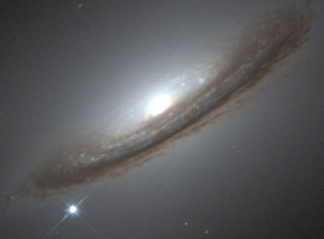
Not the End of Cosmology In 1997…
Gravity is the longest-reaching force according to physics
So, the expansion of the universe should be slowing down…
By observing supernovae in distant galaxies, researchers determine that the expansion is speeding up
Cosmologists get very excited!
Notes:
One of the big questions in cosmology was whether or not the universe would expand forever. Since gravity was the furthest-reaching force, it was expected that the expansion would slow down, but whether it would slow down enough to stop was an open question.
Researchers were trying to answer this question by measuring the slow-down rate of the expansion. To do this, they observed supernovae in distant galaxies (recall that by observing distant galaxies, they were observing galaxies far in the universe’s past).
Instead, they got the surprise of their lives…the expansion was not slowing-down, but speeding up!

Slide 18
History of the Universe’s Expansion
Video clip from DVD Beyond the Solar System: Expanding the Universe in the Classroom, produced for NASA by the Harvard-Smithsonian Center for Astrophysics. © Smithsonian Institution
Notes:
Video Clip expanding_univ.mov
Why does the expansion speed up? Cosmologists have proposed the presence of “dark energy”, but what is its nature?
These are questions that cosmologists are trying to answer today.
In fact, we ask students to look to the future in our “capstone” lesson plan, Cosmic Times 2019 – in this lesson, students speculate what we will know on the 100th anniversary of the Cosmic Times, and what technology we will have, and what questions are still unanswered.

Slide 19
2006 – Cosmologists are busy
Dark energy is well-established, having been detected in many ways
Still, the nature of dark energy is largely a mystery
Stay tuned to this continuing science story…
Fundamental science concepts: expanding universe, distances in the universe, supernovae, gravity
Notes:
In our “capstone” lesson plan, Cosmic Times 2019, we ask students to look to the future. In this lesson, students speculate what we will know on the 100th anniversary of the Cosmic Times, and what technology we will have, and what questions are still unanswered.

Slide 20
It is now 2014…
What is our view of the universe?
Finite
Changing
13.7 billion years old
Notes:
Contrast this with where we started in 1919.

Slide 21
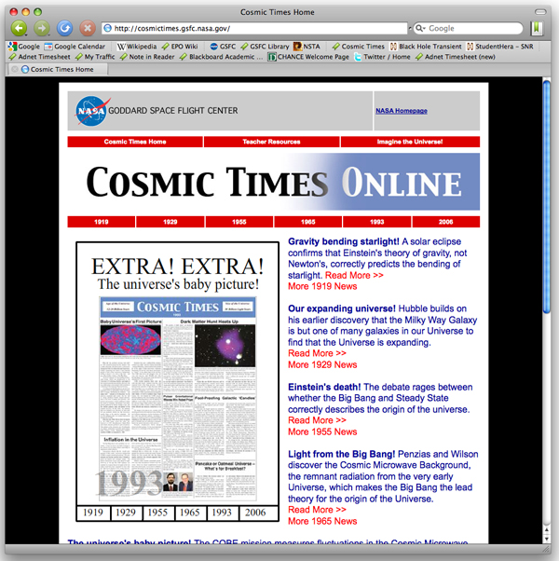
Cosmic Times
Posters, Newsletters, Teacher’s Resources, Lessons & Online-Edition all on our website: http://cosmictimes.gsfc.nasa.gov/

Slide 22
Classroom Resources: A Brief Tour
A variety of tools are available to help you navigate Cosmic Times and find the right resources for your classroom
Teacher Resources

Slide 23
Classroom Resources: A Brief Tour
A variety of tools are available to help you navigate Cosmic Times and find the right resources for your classroom

Slide 24
Classroom Resources: Guide to the Articles
Guide to the Articles

Slide 25
Classroom Resources: Guide to the Articles
Here you will find further information organized by year/issue of Cosmic Times
Year of interest

Slide 26
Classroom Resources: Guide to the Articles
Here you will find further information organized by year/issue of Cosmic Times
Downloads
Poster
Newsletters
Glossary
Questions for understanding
Additional information about each article
Classroom lesson plans

Slide 27
Classroom Resources: Curriculum Tools
Curriculum Tools

Slide 28
Classroom Resources: Curriculum Tools
Here you will find tools to help you find the right lessons and articles for your curriculum needs

Slide 29
Classroom Resources: Curriculum Tools
Here you will find tools to help you find the right lessons and articles for your curriculum needs
Sortable list of lessons

Slide 30
Classroom Resources: Curriculum Tools
Here you will find tools to help you find the right lessons and articles for your curriculum needs
Sortable list of lessons
National Education Standards for each lesson

Slide 31
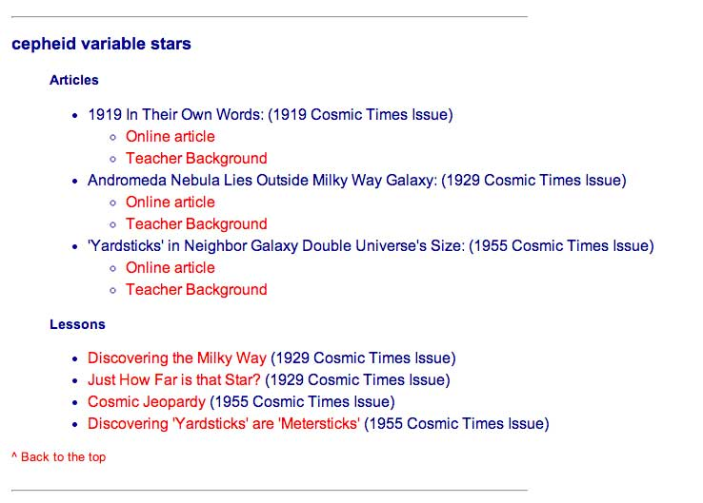
Classroom Resources: Curriculum Tools
Here you will find tools to help you find the right lessons and articles for your curriculum needs
Sortable list of lessons
National Education Standards for each lesson
Keyword clouds
Click a keyword
See related articles and lessons

Slide 32
Classroom Resources: Curriculum Tools
Here you will find tools to help you find the right lessons and articles for your curriculum needs
Sortable list of lessons
National Education Standards for each lesson
Keyword clouds
Master download page

Slide 33
2019 Cosmic Times
In the capstone lesson plan, students are asked to look to the future
Students speculate what we will know on the 100th anniversary of the Cosmic Times, what technology we will have, and what questions are still unanswered
We’re inviting submissions for a possible “student gallery” of 2019 Cosmic Times creations
See the website for more

Slide 34
Cosmic Times
Posters, Newsletters, Teacher’s Resources, Lessons & Online-Edition all on our website: http://cosmictimes.gsfc.nasa.gov/

Slide 36
Century Timeline
Compare the Cosmic Times timeline with events in:
Other Science
Arts/Entertainment/Culture
World History/Politics
Opportunities for cross-disciplinary collaboration
Notes:
To wrap up this story, it might be useful to put the stories in the context of other historic events. This is one of the lesson plans included with the 2006 issue of Cosmic Times, but could be done with any individual issue to help students connect the science story to history they’ve learned in other classes.

Slide 37
Cosmic Times Timeline
1912 - Henrietta Leavitt determines Cepheid Period-Luminosity relationship
1916 - Einstein’s Theory of Gravity
1929 - Hubble’s Law
1934 - “Super-nova” identified by Baade & Zwicky
1949 - Alpher & Gamow discuss nucleosynthesis
1952 - Baade recalibrates Cepheid P-L relationship
1965 - Penzias & Wilson discover CMB
1970 - Vera Rubin makes case for Dark Matter
1981 - Guth proposes Cosmic Inflation
1993 - COBE measures anisotropies in CMB
1998 - Dark Energy discovered
2003 - WMAP refines anisotropies in CMB

